Slide 1
Reuse-based Software engineering
Application system reuse
The whole of an application system may be reused either by incorporating it without change into other systems (COTS reuse) or by developing application families.
Component reuse
Components of an application from sub-systems to single objects may be reused.
Object and function reuse
Software components that implement a single well-defined object or function may be reused.
A software engineering strategy where the development process is geared to reusing existing software.

Slide 2
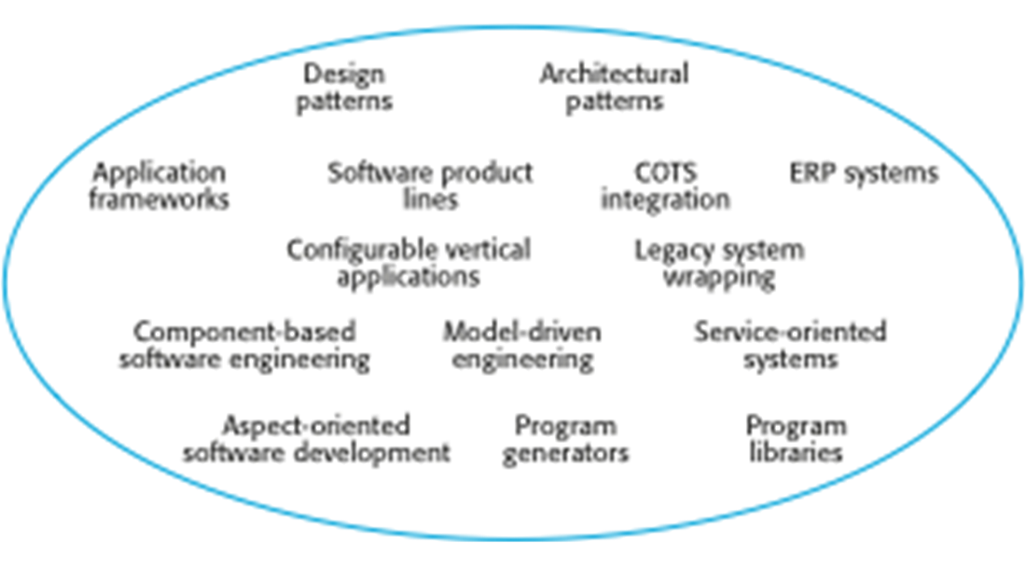
The reuse landscape
Although reuse is often simply thought of as the reuse of system components, there are many different approaches to reuse that may be used.
Reuse is possible at a range of levels from simple functions to complete application systems.
The reuse landscape covers the range of possible reuse techniques.

Slide 3
In summary
The advantages of software reuse are lower costs, faster software development and lower risks. System dependability is increased. Specialists can be used more effectively by concentrating their expertise on the design of reusable components.
Application frameworks are collections of concrete and abstract objects that are designed for reuse through specialization and the addition of new objects. They usually incorporate good design practice through design patterns.
Most new business software systems are now developed by reusing knowledge and code from previously implemented systems.
There are many different ways to reuse software. These range from the reuse of classes and methods in libraries to the reuse of complete application systems.

